Slide 1
Lesson 8: Generalised Least Squares

Slide 2
Assumptions of linear models
Linear models make many assumptions, including:
The model makes biological sense/ physical sense
Additivity (terms are added together)
Linearity
Independence of errors
Homoscedasticity – equal variance of errors
Normality of errors.

Slide 3
Two situations where GLS is useful
Data heteroscedasticity (unclear mean-variance relationships)
Autocorrelation between data points (non-independence)

Slide 4
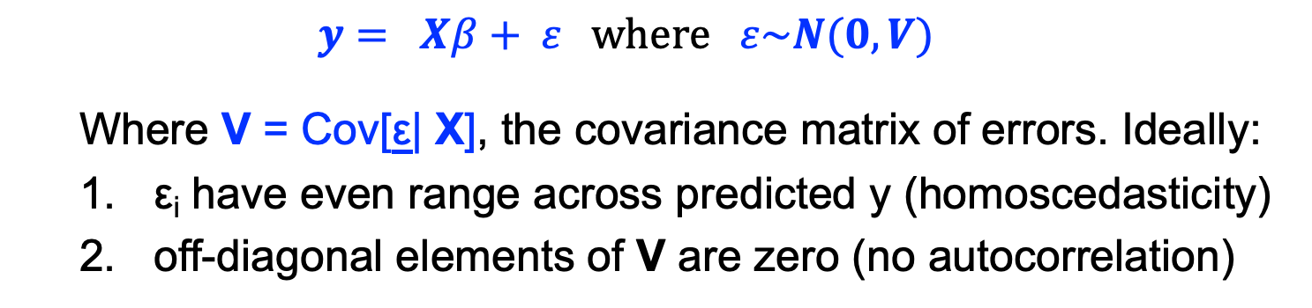
Linear model with ‘good’ error
$y= Xβ+ ε where ε\sim N(0,V)$
Where V = Cov[ε| X], the covariance matrix of errors. Ideally:
ε_{i} have even range across predicted y (homoscedasticity)
off-diagonal elements of V are zero (no autocorrelation)
✔

Slide 5
Linear model with heteroscedasticity and/ or error covariance
In reality ε ~ N(0, V) , where :
ε_{i} are heteroscedastic
Off-diagonal elements are non-zero (covariance)
✗

Slide 6
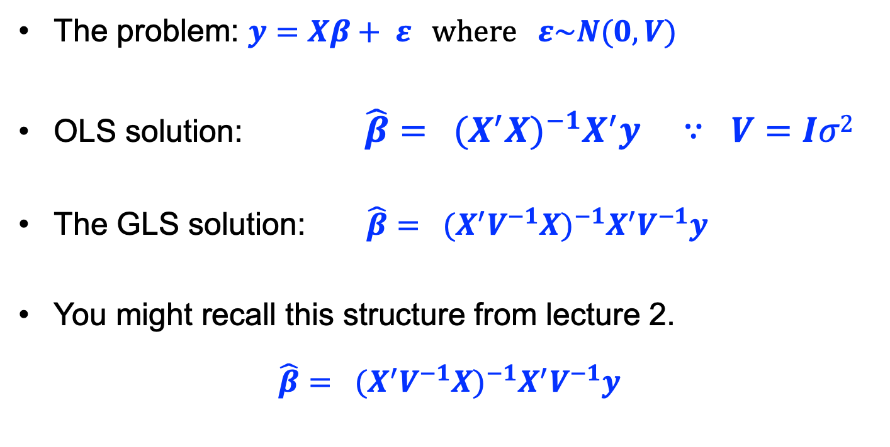
Generalised least squares models
The problem: $y=Xβ+ ε where ε\sim N(0,V)$
OLS solution: $\hat{β}= {{(X}^{′}X)}^{−1}X^{′}y ∵ V=Iσ2$
The GLS solution: $\hat{β}= {{(X}^{′}V^{−1}X)}^{−1}X^{′}V^{−1}y$
You might recall this structure from lecture 2.
$$\hat{β}= {{(X}^{′}V^{−1}X)}^{−1}X^{′}V^{−1}y$$

Slide 7
We will deal with heteroscedasticity and error covariance separately in the remaining problems
To be clear:
Heteroscedasticity is about the diagonal elements (homoscedastic residuals should be ~equal in size)
Error covariance is about the off-diagonal elements (should be close to zero i.e. uncorrelated)

Slide 8
1. Heteroscedascity
✗

Slide 9
1. Dealing with heteroscedascity
Usually we try to define relationships between means and variances, e.g. Poisson, Binomial or Gamma distributions.
Sometimes we might need more flexibility if we are uncertain about the mean-variance relationship
CAVEAT: I find it quite difficult to decide when to apply these methods UNLESS I already know that the mean-variance relationship is systematically skewed and cannot be described by a known distribution

Slide 10
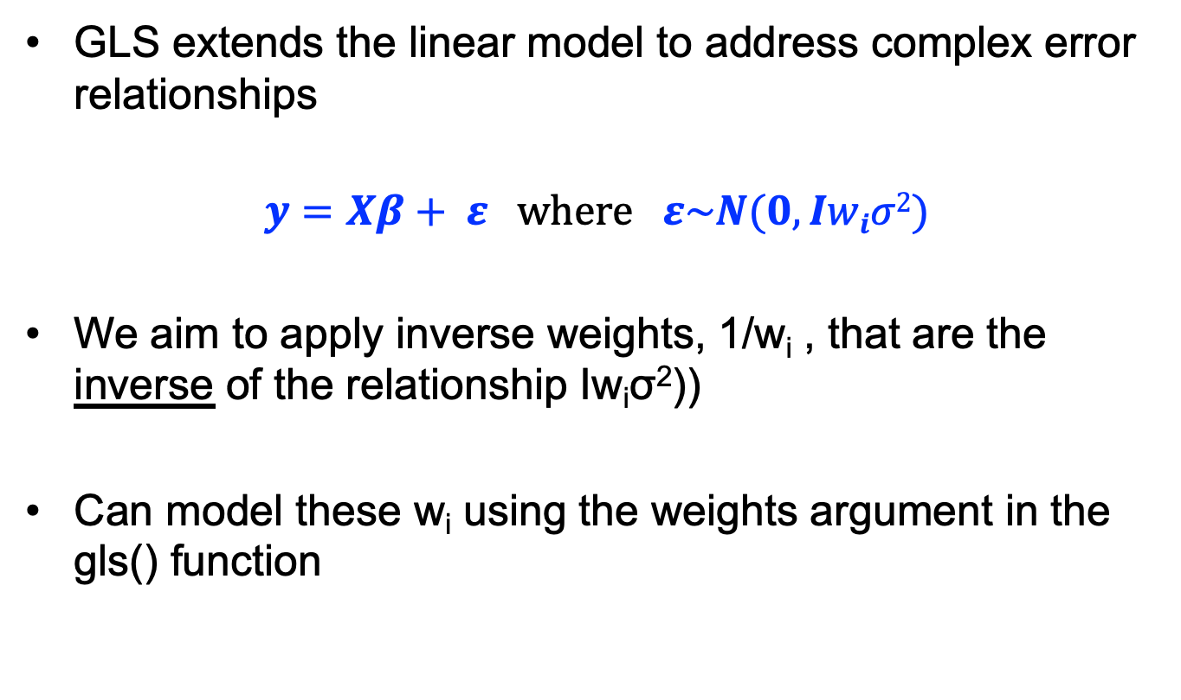
Generalised Least Squares
GLS extends the linear model to address complex error relationships
$$y=Xβ+ ε where ε\sim N(0,Iwiσ2)$$
We aim to apply inverse weights, 1/w_{i} , that are the inverse of the relationship Iw_{i}σ²))
Can model these w_{i} using the weights argument in the gls() function

Slide 11
The gls() function
mod <- gls(y~x, data=dat, weights=varFixed(form=~1/w²))
Variance function. Options include:
varFixed: weights are linear
varPower: weights are power-law
varIdent: weights differ by factor level
Express the weights in terms of the covariate

Slide 12
The lme()function
The lme() function allows one to include random effects into the mix as well
mod <- lme(y~x, random=~1|group, data=dat, weights=varFixed(form=~1/w²))

Slide 13
Code 8.1 Heteroscedastic models

Slide 14
Exercise 8.1
Return to the plantdamage example.
Fit a random effects model with lme to test whether damage, light and their interaction affects growth.
Use growth in untransformed form.
First, run the model assuming no covariance structure (mod 1) and plot the residuals.
Inspect the lme model for evidence of heteroscedasticity. Try this command
Ps: plot(mod, resid(.)~fitted(.)|light, abline=0, layout=c(2, 1))
Then try varIdent and varExp models (mod 1b, mod 1c) and compare them against your first model using AIC and plot their residuals.
Second, assume growth is exponentially distributed. Transform it and run the model assuming no co-variance structure (mod 2), and plot the residuals.
Then try varIdent and varExp models with the transformed growth and compare them using AIC. (mod 2b, mod 2c)
Finally compare the summaries from mod 1c and mod 2.

Slide 15
2. Autocorrelation
✗

Slide 16
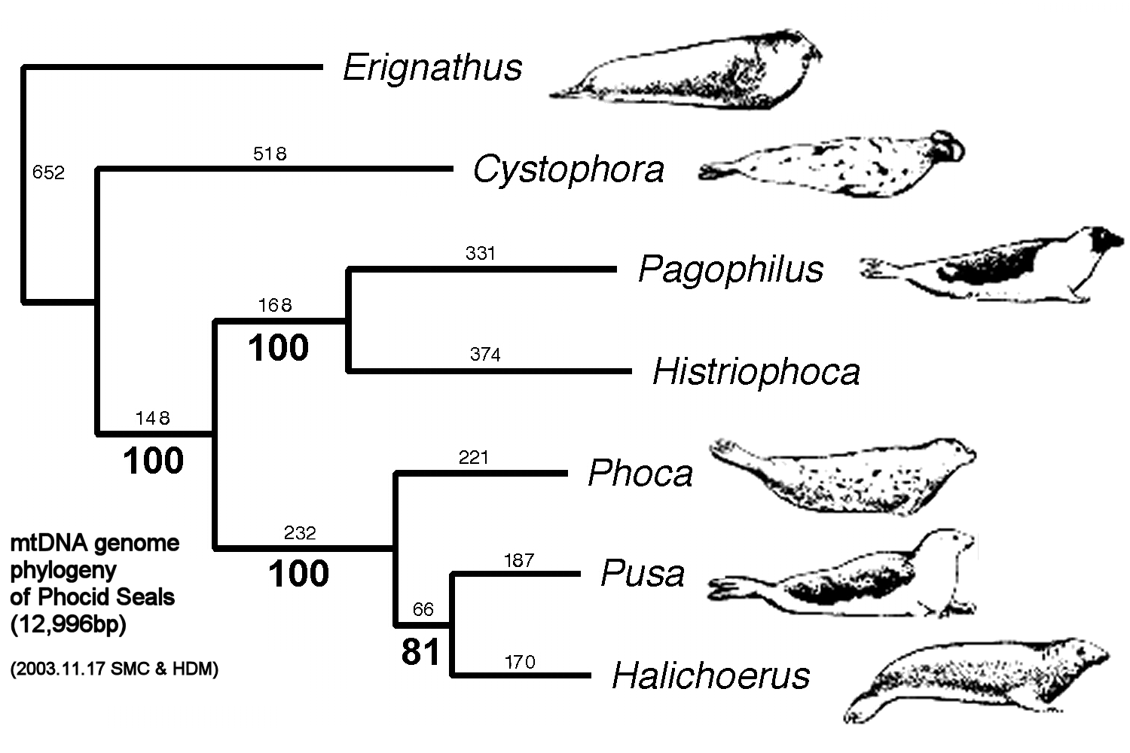
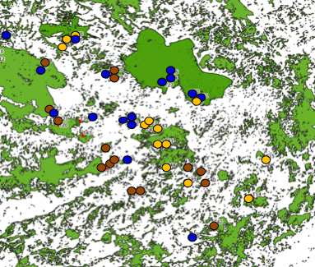
2. Dealing with auto-correlation
Data points that are close together in space, time or phylogeny are not independent.

Slide 17
2. Dealing with auto-correlation
Data points that are close together in space, time or phylogeny are not independent.
Difficult to turn these relationships into discrete blocks (as we did for LMMs).
Possible to model the auto-correlation directly with gls()and lme() using the correlation argument.

Slide 18
Covariance structures in gls
All linear models have the form
Y = Xβ + ε such that ε ~ N(0, V)
Where sigma is a n x n matrix.
Each value, from row i and column j is the covariance of the errors of replicates i and j
OLS models assume that V ~ Iσ² (in other words: off-diagonal covariances are close to zero)
In GLS we essentially describe the relationships in V using an assumed covariance structure

Slide 19
Covariance between data
Consider the correlation between
plant communties in space.
In the figure, it is clear that closer
communities are more similar.
This could be because of geology
But it could also be because
plants have a higher chance of
establishing offspring closer to a mother tree
This relatedness effect falls off as two points move further apart..
i.e. the correlation between points decreases with distance

Slide 20
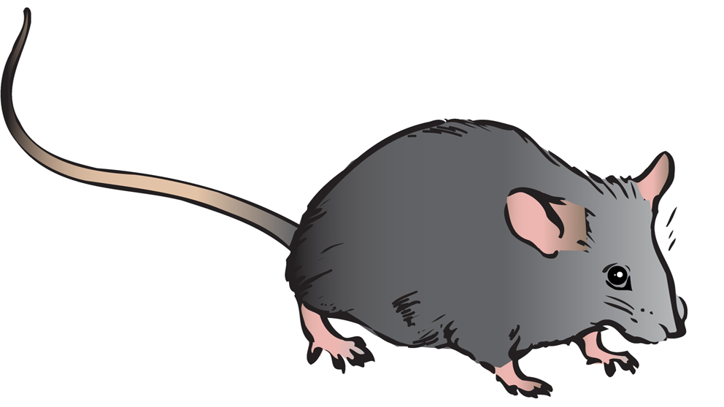
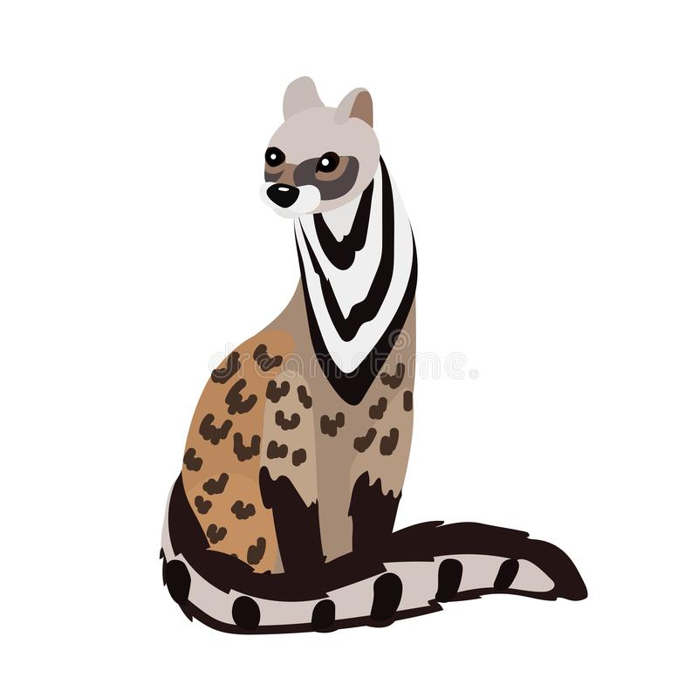
Covariance between data
Take homes:
1. Spatial autocorrelation is due to
some process that we may find
difficult to diagnose properly
2. The autocorrelation process
often has a spatial limit
e.g. max distance of seed dispersal
3. The autocorrelation-dist relationship
has a shape!
Dispersal probability
Distance from mother tree

Slide 21

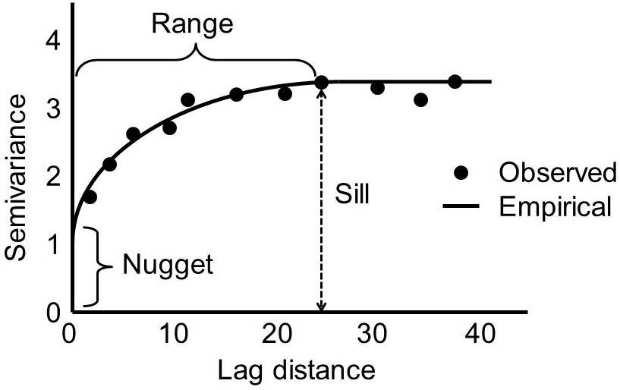
Describing covariance between data points: Semivariograms
Semi-variograms describe differences (variance) between data points in terms of some distance measure (space, time, DNA).
Range: distance over which points are correlated in space/ time
Sill: average distance between uncorrelated data points = variance
Nugget: some variance at small scale (stochasticity?/ measurement error?)

Slide 22
Fitting a correlation structure
Distance correlation relationships have pattern;
mod <- gls(y~x, data=dat, correlation=corExp(form=~x+y))
Dependency decreases as an exponential function of distance.
Other options:
corSpher
corGaus
corLin
corRatio

Slide 23
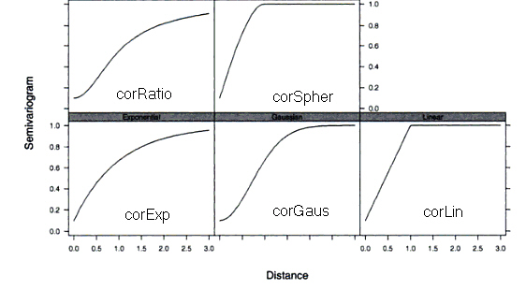
Correlation structures for shapes
Pinheiro and Bates 2004, p. 233

Slide 24
Approach
1) fit a basic model without a correlation structure,
2) examine a variogram of the residuals (i.e., their correlation with respect to distance),
3) choose an appropriate corStruct class based on the variogram shape (maybe test a few..), and
4) test whether addition of the correlation term significantly improves model fit via AICs or LRTs (anova function).
Use Variogram function in nlme to diagnose the type:
plot(Variogram(gls1,form=~lon+lat))

Slide 25
Code 8.2 Spatial correlation structures

Slide 26
Exercise 8.2
The data in the file trees.csv come from an analysis of tree growth in an Austrian forest.
The response of Relative growth rate (RGR) to light was compared between two species (beech and spruce)
Determine if there is an interaction between species and light in their effects on RGR
Are the residuals independent?
Modify the models to deal with any spatial dependence

